Slide 1


PANIMALAR ENGINEERING COLLEGE
DEPARTMENT OF COMPUTER SCIENCE AND ENGINEERING
CS8811 PROJECT WORK
DRIVER DROWSINESS ALERT SYSTEM USING
DEEP LEARNING
Guide Name: Thyagarajan C,M.E.,Ph.D.,
ASSISTANT PROFFESSOR,
DEPARTMENT OF CSE,
PANIMALAR ENGINEERING COLLEGE
Team : Venkata Sai Prakash Y(211418104307), Gattu Ashish(211418104060),Yeluri Harish(211418104314)
BATCH NO : C17

Slide 2
INTRODUCTION
Driver’s inattention might be the result of a lack of alertness when driving due
to driver drowsiness and distraction.
Driver distraction occurs when an object or event draws a person’s attention
away from the driving task.
Unlike driver distraction, driver drowsiness involves no triggering event but, instead, is characterized by a progressive withdrawal of attention from the road and traffic demands.
Both driver drowsiness and distraction, however, might have the same effects, that is decreased driving performance, longer reaction time, and an increased risk of crash involvement.

Slide 3
Literature survey ( IEEE, Springer, Science Direct )
S.NO | TITLE | AUTHORS | INFERENCE | ALGORITHM
1. 2. | Object Detection Using Deep Learning, September 2021, 2nd International Conference On Advances In Computing,, Embedded And Secure Systems (ACCESS) Deep Face Recognition: A Survey, March 2020, IEEE Transactions on Affective Computing | Pradnya Kedari; Mihir Kapile; Divya Kadole; Sagar Jaikar Shan Li and Weihong Deng | Using deep learning algorithm to identify the basic human face including FER-2013 (Facial identification) Deep neural networks have increasingly been leveraged to learn discriminative representations for automatic FER. Recent deep FER systems | Deep Learning, Python OpenCV and CV2

Slide 4
PROBLEM STATEMENT
The drowsiness detection system can be used for different applications.
One of them is heavy vehicles for example trucks, since the drivers of trucks have long driving periods.
It can also be used for commercial vehicles. Many people use public transport facility for travelling.
For their safety this system can be used in public vehicles. Heavy things are lifted by using cranes and transporting them to other places.
So for overloaded cranes and mobile cranes this system can be used to avoid accidents related to drowsiness.

Slide 5
HARDWARE AND SOFTWARE REQUIREMENTS
Hardware specifications:
Webcam or Camera
RAM, of about 1GB or above
Processor of frequency 1.5GHz or above
Software specifications:
Python 3.6 and higher
Anaconda software

Slide 6
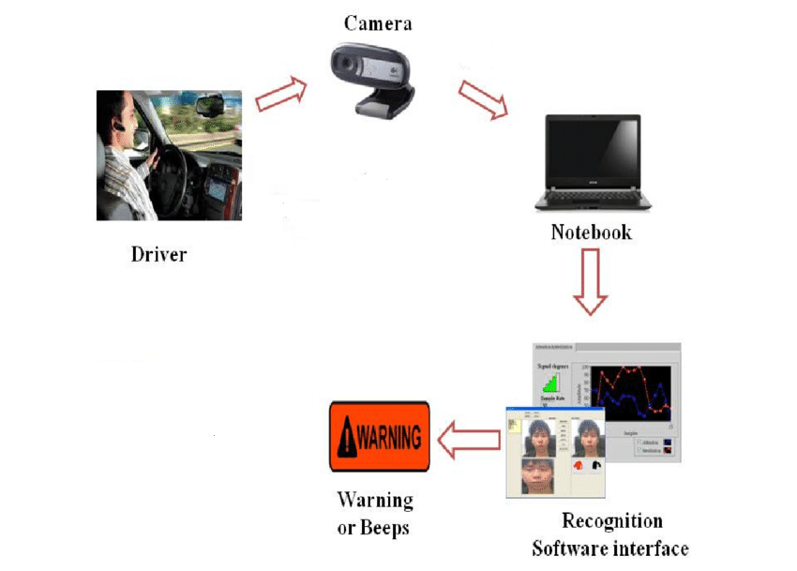
SYSTEM ARCHITECTURE

Slide 7
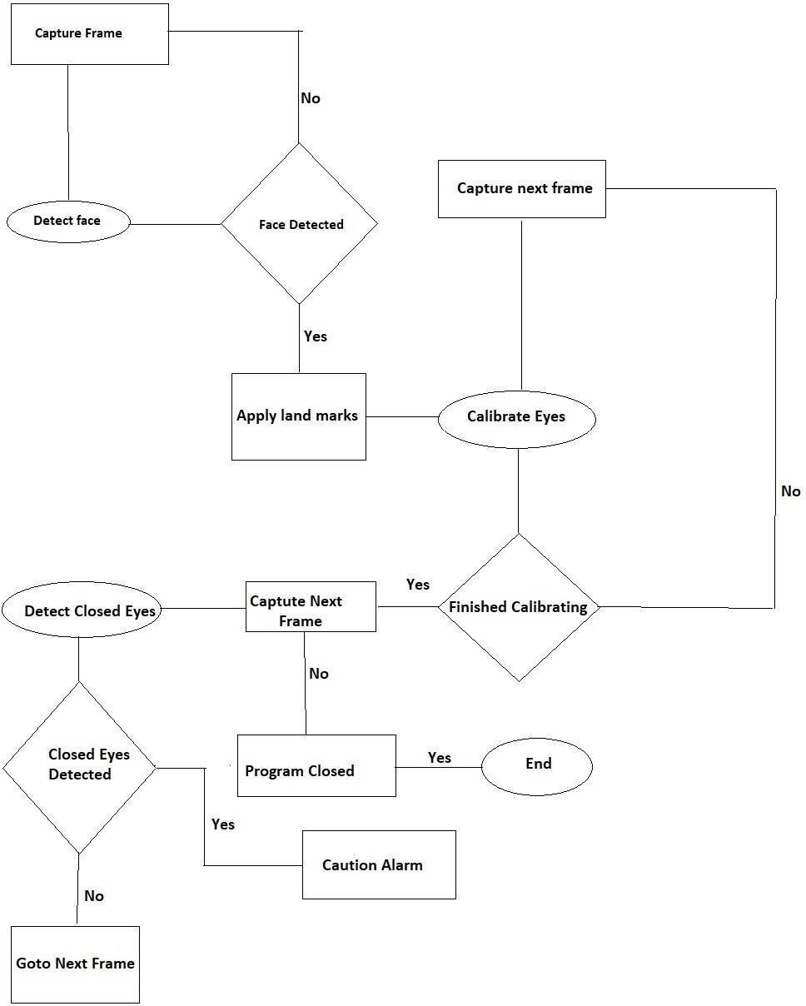
E-R DIAGRAM

Slide 8
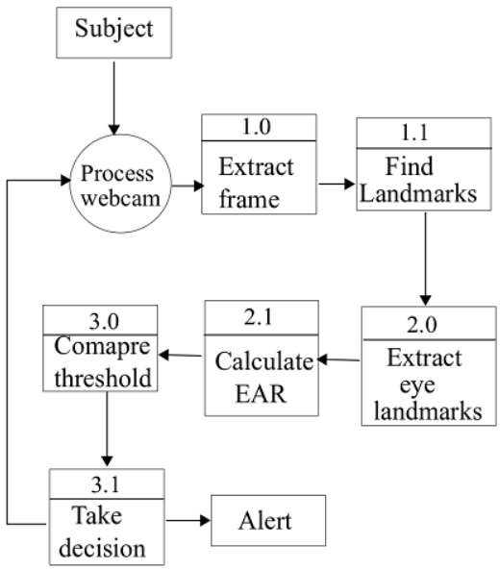
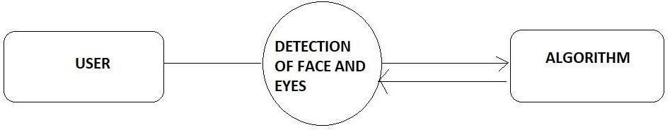
DFD DIAGRAM

Slide 9
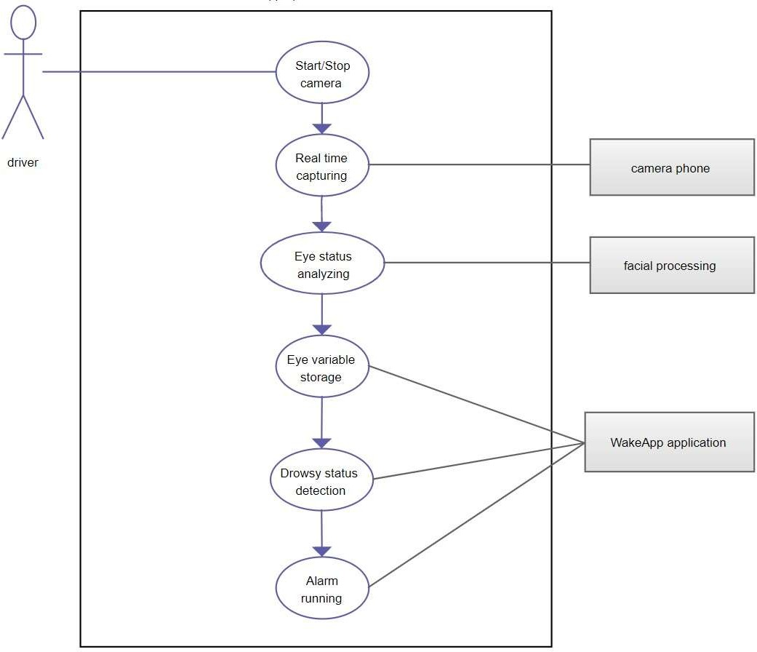
USE CASE DIAGRAM
Detection System

Slide 10
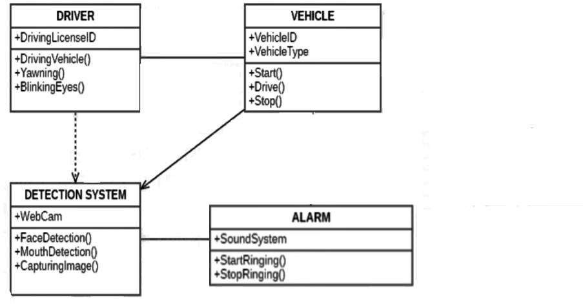
CLASS DIAGRAM

Slide 11
MODULE DESCRIPTION
Object Detection using Haar feature-based cascade classifiers is an effective Now all possible sizes and locations of each kernel is used to calculate plenty of features. (Just imagine how much computation it needs? Even a 24x24 window results over 160000 features).
For each feature calculation, we need to find sum of pixels under white and black rectangles.
To solve this, they introduced the integral images. It simplifies calculation of sum of pixels, how large may be the number of pixels, to an operation involving just four pixels. Nice, isn’t it? It makes things super-fast.

Slide 12
For this they introduced the concept of Cascade of Classifiers. Instead ofapplying all the 6000 features on a window, group the features into different stages of classifiers and apply one-by-one. (Normally first few stages will contain very less number of features).
If a window fails the first stage, discard it. We don’t consider remaining features on it
But among all these features we calculated, most of them are irrelevant.
For example, consider the image below. Top row shows two good features. The first feature selected seems to focus on the property that the region of the eyes is often darker than the region of the nose and cheeks.

Slide 13
If it passes, apply the second stage of features and continue the process. The window which passes all stages is a face region.
Authors’ detector had 6000+ features with 38 stages with 1, 10, 25, 25 and 50 featuresin first five stages. (Two features in the above image is actually obtainedas the best two features from Adaboost).
According to authors, on an average, 10features out of 6000+ are evaluated per sub-window.
Haar-cascade Detection in OpenCV comes with a trainer as well as detector

Slide 14
Haar-cascade Detection in OpenCV comes with a trainer as well as detector. If you want to train your own classifier for any object like car, planes etc. you can use OpenCV to create one. Its fulldetails are given here: Cascade Classifier Training.
First we need to load the required XML classifiers. Then load our input image (or video) in grayscale mode.
MODULE 2: Classification
We are using CNN classifier for predicting the eye status. To feed our image into the model, we need to perform certain operations because the model needsthe correct dimensions to start with.
First, we convert the color image into grayscale using r_eye = cv2.cvtColor(r_eye, cv2.COLOR_BGR2GRAY).

Slide 15
There are many metrics that can be used to measure the performance of a classifier or predictor; different fields have different preferences for specific metrics due to different goals. In medicine sensitivity and specificity are often used, while in information retrieval precision and recall are preferred.
An important distinction is between metrics that are independent of how often each category occurs in the population (the prevalence), and metrics that depend on the prevalence – both types are useful, but they have very different properties.
Given a classification of a specific data set, there are four basic combinations of actual data category and assigned category: true positives TP (correct positive assignments), true negatives TN (correct negative assignments), false positives FP (incorrect positive assignments), and false negatives FN (incorrect negative assignments).

Slide 16
There are many metrics that can be used to measure the performance of a classifier or predictor; different fields have different preferences for specific metrics due to different goals.
In medicine sensitivity and specificity are often used, while in information retrieval precision and recall are preferred.
An important distinction is between metrics that are independent of how often each category occurs in the population (the prevalence), and metrics that depend on the prevalence – both types are useful, but they have very different properties.

Slide 17
Given a classification of a specific data set, there are four basic combinations of actual data category and assigned category: true positives TP (correct positive assignments), true negatives TN (correct negative assignments), false positives FP (incorrect positive assignments), and false negatives FN (incorrect negative assignments).

Slide 18
testing
TEST ID | TEST CONDITION | SYSTEM BEHAVIOUR | SYSTEM BEHAVIOUR | EXPECTED RESULT
T01 | NSGW | Straight Face,Good Light,With Glasses | Non Drowsy | Non Drowsy
T02 | DTGN | Tilted Face,Good Light,No Glasses | Drowsy | Drowsy
T03 | DTGY | Tilted Face,Good Light,With Glasses | Drowsy | Drowsy
T04 | NSDN | Straight Face,Dim Light,Without Glasses | Non Drowsy | Non Drowsy

Slide 19
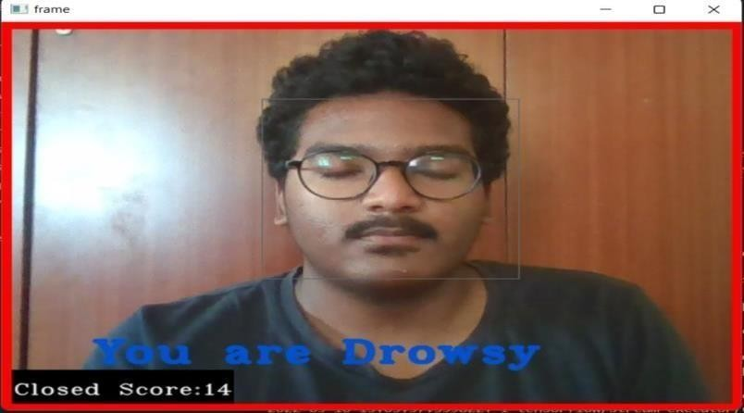
SCREEN SHOTS
SCREEN SHOT WHEN YOU ARE FEELING DROWSY WITH SPECTACLES IN GOOD LIGHT CONDITIONS

Slide 20
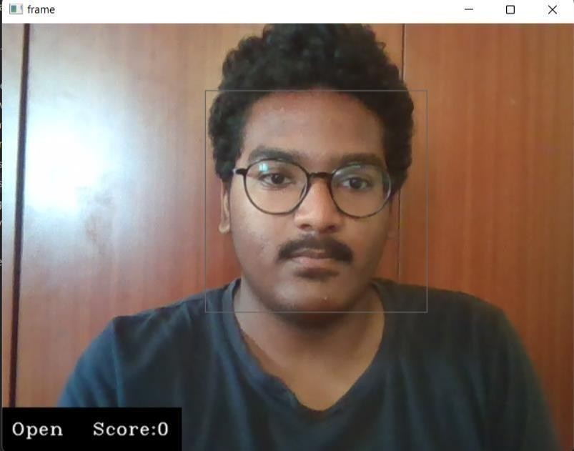
SCREEN SHOT OF WHEN YOU ARE NOT FEELING DROWSY WITH SPECTACLES IN GOOD LIGHT CONDITIONS

Slide 21

SCREEN SHOT WHEN YOU ARE NOT FEELING DROWSY WITHOUT SPECTACLES IN LOW LIGHT CONDITIONS

Slide 22
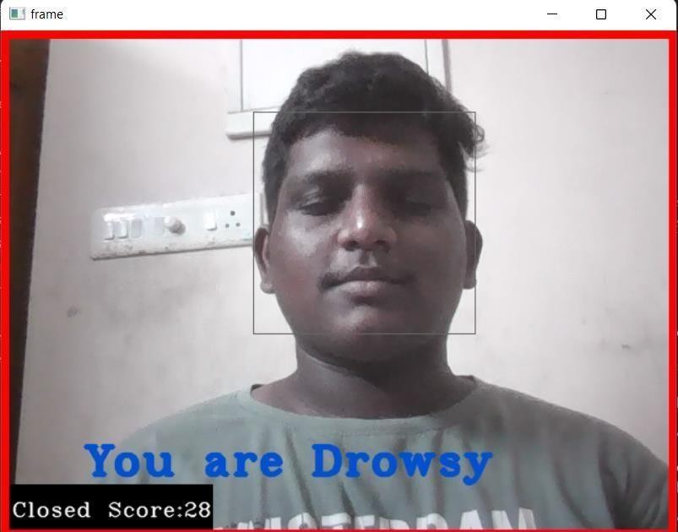
SCREEN SHOT WHEN YOU ARE FEELING DROWSY WITHOUT SPECTACLES IN LOW LIGHT CONDITIONS

Slide 23
CONCLUSION
Purpose of our project is to help solving real life problem in very cost effect way. It alerts the driver.
Whenever the driver feels drowsy and closes his eyes for more than a second, the buzzer is blown. As a result, it alerts the driver.
As a result the accident ratio decreases. Hence, our project if commercially developed will help in saving the precious life of truck drivers who travel long distances for days.

Slide 24
REFERENCES
Websites:
https://pypi.org/project/opencv-python/
https://keras.io/
https://www.pyimagesearch.com/2017/05/08/drowsiness-detection-opencv/
Wafa Mellouk; Wahida Handouzi, “Facial emotion recognition using deep learning: review and insights”, The
2nd International Workshop on the Future of Internet of Everything (FIoE), Belgium, Aug 2020
Ji-Hae Kim; Byung-gyu Kim; Partha Pratim Roy; Da-mi Jeong, “Efficient Facial Expression Recognition
Algorithm Based on Hierarchical Deep Neural Network Structure”, Department of IT Engineering, Sookmyung
Women’s University, Seoul, South Korea, March 2019
Alice Othmania; Abdul Rahman Taleb; Hazem Abdelkawy; Abdenour Hadid, “Age estimation from faces using deep learning: a comparative analysis”, Computer Vision and Image Understanding, Volume 196, 102961, July 2020

Slide 25

Plagiarism Report

